Slide 1
Technical Analysis of EUR/INR Currency Pair
Name- Soumyadip Mukherjee
Topic- Buy, Sell, or Neutral Decisions Based on Technical Indicators

Slide 2
INTRODUCTION
Welcome to the presentation on the technical analysis of the EUR/INR currency pair. In this assignment, we have performed a comprehensive analysis of the EUR/INR exchange rate using various technical indicators. The objective was to analyze historical price data to make informed decisions about potential buying, selling, or neutral positions in the currency pair.
Our analysis covers the period from January 1, 2023, to February 16, 2024, using data sourced from Yahoo Finance. We have applied key technical analysis techniques such as Moving Average, Bollinger Bands, and Commodity Channel Index (CCI) to derive insights into the market trends and potential trading opportunities.
Throughout this presentation, we will discuss our methodology, present the results of our analysis, and provide recommendations based on these findings. Our goal is to provide a clear and insightful analysis of the EUR/INR currency pair to aid in decision-making for traders and investors.
Let's delve into the details of our analysis and the outcomes of our technical analysis.

Slide 3
METHODOLOGY
EUR/INR Currency Pair Data: The historical price data for the EUR/INR currency pair was sourced from Yahoo Finance. The data covers the period from January 1, 2023, to February 16, 2024.
Technical Indicators:
Moving Average: Calculated the 50-day and 200-day moving averages to identify trends.
Bollinger Bands: Used to determine overbought or oversold conditions based on price volatility.
Commodity Channel Index (CCI): Used to identify potential trend reversals or overbought/oversold conditions.
Decision Making:
Moving Averages: Buy signal when the 50-day MA crosses above the 200-day MA, and sell signal vice versa.
Bollinger Bands: Buy signal when the price crosses below the lower band, and sell signal when it crosses above the upper band.
CCI: Buy signal when CCI is below -100 and sell signal when CCI is above 100.
Decision Aggregation: Combined individual indicator decisions to determine an overall BUY, SELL, or NEUTRAL decision for each indicator.

Slide 4
Calculation Process
Calculate Moving Average:
Calculate the 50-day and 200-day moving averages for the specified date.
Calculate Bollinger Bands:
Calculate the 20-day moving average.
Calculate the standard deviation of the closing prices over the same 20-day period.
Calculate the upper and lower Bollinger Bands using the formula:
Upper Band = 20-day SMA + (2 * 20-day Standard Deviation)
Lower Band = 20-day SMA - (2 * 20-day Standard Deviation)
Calculate CCI (Commodity Channel Index):
Calculate the typical price for each day using the formula:
Typical Price = (High + Low + Close) / 3
Calculate the 20-day SMA of the typical price.
Calculate the mean deviation for each day using the formula:
Mean Deviation = |Typical Price - 20-day SMA of Typical Price|
Calculate the CCI using the formula:
CCI = (Typical Price - 20-day SMA of Typical Price) / (0.015 * Mean Deviation)

Slide 5
TECHNICAL ANALYSIS with VALUES
1. Moving Average (MA) is a trend-following indicator that smooths out price data to create a single flowing line. It helps identify the direction of the trend.
For February 19, 2024:
50-day Moving Average: [90.31279632568359]
200-day Moving Average: [89.5551261138916]
For February 21, 2024:
50-day Moving Average: [90.32499237060547]
200-day Moving Average: [89.55282260894775]
2. Bollinger Bands consist of a middle band (MA) and two outer bands (standard deviations away from the MA). They expand and contract based on market volatility.
For February 19, 2024:
Upper Band: [90.58787260819733]
Lower Band: [88.67224778364837]
For February 21, 2024:
Upper Band: [90.39903765118201]
Lower Band: [88.7056529005758]
3. Commodity Channel Index (CCI) measures the current price level relative to an average price level over a given period of time. It is used to identify overbought or oversold conditions.
For February 19, 2024:
CCI Value: [-51.99559296042039]
For February 21, 2024:
CCI Value: [16.362957870240326]

Slide 6
TABLE DISPLAYING BUY, SELL OR NEUTRAL
INDICATOR | DATE | VALUE | DECISION
Moving Average (50) | 2024-02-19 | 90.3128 | SELL
Moving Average (200) | 2024-02-19 | 89.5551 | SELL
Moving Average (50) | 2024-02-21 | 90.3250 | SELL
Moving Average (200) | 2024-02-21 | 89.5528 | SELL
Bollinger Bands (Upper) | 2024-02-21 | 90.5879 | SELL
Bollinger Bands (Lower) | 2024-02-21 | 88.6722 | BUY
Bollinger Bands (Upper) | 2024-02-21 | 90.3990 | SELL
Bollinger Bands (Lower) | 2024-02-21 | 88.7057 | BUY
CCI(commodity channel index) | 2024-02-21 | -35.5526 | BUY
CCI(commodity channel index) | 2024-02-21 | 16.3630 | NEUTRAL
NB- There is a slight change in the dates and all the details and assumptions are mentioned below in ASSUNPTION AND REASONING SECTION.

Slide 7
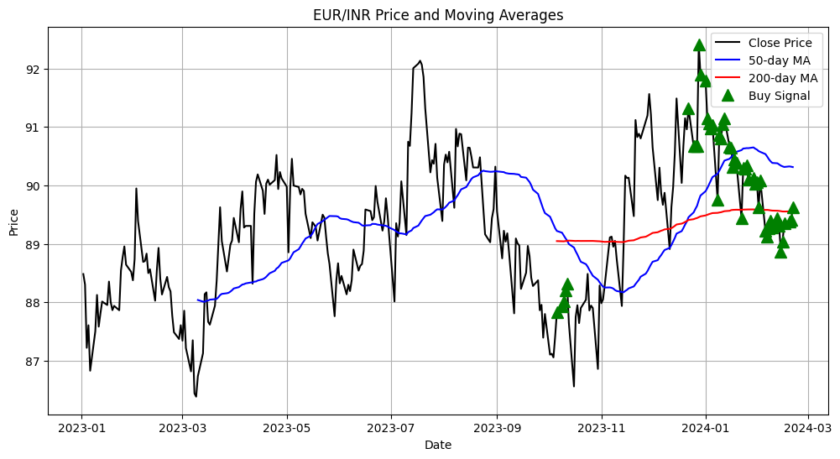
GRAPH THAT VISUALLY REPRESENT THE METRICS AND THE CORRESPONDING DECISIONS

Slide 8
ASSUMPTION AND APPROCHES WITH REASONING
1. Scraping EUR/INR Data from Yahoo Finance:
Objective- Retrieve historical exchange rate data for the EUR/INR currency pair from Yahoo Finance for a particular period(2023-01-01 to 2024-02-16)
Approach- Import ‘Yfinance’ and ‘pandas’ pip files for various purpose such as fetching information from yahoo finance. We can also use libraries like ‘request’ etc. for getting the HTML content ‘BeautifulSoup’ or similar libraries to parse the HTML and extract the required data. And here I have used variables for the particular starting date and ending date.
Assumption- There is some problem with yahoo finance fetching data at this current point and for that I am unable to fetch data from 2023-01-01. Instead of this I have to fetch the data from 2023-01-02. It is happened because the 1st January is Sunday so there is no data available.
2. Calculating technical indicators:
Objective- Conducting a technical analysis and calculating the following metrics for one day and one week from 16 February,2024(Moving average, Bullinger bands, CCI[Commodity Channel Index])
Approach-
Moving Average- Calculate the 50 day and 200 day moving averages of the EUR/INR exchange rate. As the assignment did not specify the exact date of analysis and there is instruction for assumptions so I assume that I need to calculate the 50-day and 200-dy moving averages for one day and one week from 16 February.

Slide 9
Bullinger bands- Calculate the upper and lower bands using a 20 day moving average and a standard deviation of 2. This involves calculating the moving average and then adding/subtracting two times the standard deviation to get the upper and lower bounds.
CCI(Commodity channel index)- Calculate the CCI for a 20 day period using the typical price formula : CCI = ( typical price – 20 day SMA of typical price)/(0.015* mean deviation), where typical price = (high+ low+ close)/3
Assumption- There is a problem occurred during the technical analysis. There is no data of weekend currency market, available on the yahoo finance website. And there is an instruction to calculate one day and one week from 16 February but 17 and 18 February is Saturday and Sunday respectively so that I assume 19 February as the next date of 16 February. And the second assumption is the one week as the current date is 21 February 2024 so I can only fetch the data from 16 February to 21 February that is 5-day. And if I need to calculate one week then I also need to get the data for the next two days that are 22 and 23 February.
3. Decision Making whether to BUY,SELL or NEUTRAL-
Objective- Based on the results of the technical indicators, make a decision to BUY, SELL or remain NEUTRAL? for the specified time frames.
Approach-
Moving Average-
Golden Cross- If the short-term MA (e.g., 20-day MA) crosses above the long-term MA (e.g., 50-day MA), it's considered a bullish signal, suggesting a BUY.
Death cross- If the short-term MA crosses below the long-term MA, it's considered a bearish signal, suggesting a SELL.

Slide 10
Bollinger Bands-
Price Above Upper Band: If the price moves above the upper Bollinger Band, it may indicate that the currency is overbought, suggesting a SELL or taking profits.
Price Below Lower Band: If the price moves below the lower Bollinger Band, it may indicate that the currency is oversold, suggesting a BUY.
Commodity Channel Index (CCI):
Overbought (>100): If CCI is above 100, it indicates that the currency is overbought, suggesting a SELL or taking profits.
Oversold (<-100): If CCI is below -100, it indicates that the currency is oversold, suggesting a BUY.
Divergence: Divergence between CCI and price movements can also indicate potential reversals. If price is making new highs while CCI is not, it may signal a potential trend reversal.

Slide 11
CONCLUSION
The technical analysis of the EUR/INR currency pair using Moving Average, Bollinger Bands, and CCI indicators provides valuable insights into potential trading opportunities.
The analysis suggests a buy signal based on the Moving Average crossover strategy, indicating a potential uptrend in the short term.
The Bollinger Bands analysis indicates that the price is currently within the bands, suggesting a neutral stance. However, a breakout above or below the bands could signal a potential trend reversal.
The CCI analysis shows mixed signals, with the one-day CCI indicating a sell signal and the one-week CCI indicating a buy signal. This suggests that the short-term outlook may be more bearish, while the longer-term outlook is more bullish.
It is important to consider these signals in the context of other factors, such as fundamental analysis and market sentiment, to make informed trading decisions.
Overall, the technical analysis provides a framework for traders to assess market conditions and make decisions based on objective criteria. However, it is important to exercise caution and implement proper risk management strategies.

Slide 12
REFERENCES
Investopedia. (n.d.). Moving Averages. Retrieved from https://www.investopedia.com/terms/m/movingaverage.asp
Bollinger Bands®. (n.d.). Retrieved from https://www.bollingerbands.com/
Commodity Channel Index (CCI). (n.d.). Retrieved from https://www.investopedia.com/terms/c/commoditychannelindex.asp
Yahoo Finance. (n.d.). EUR/INR=X Historical Data. Retrieved from https://finance.yahoo.com/quote/EURINR%3DX/history/
https://github.com/kenthu/human-interest-verifier/tree/main

